Slide 1

CE301 – Countering Drones
Jonathan Devaux

Slide 2
Challenge week aims
Types of Drones
Ethical & Unethical use
Research on early warning systems
Make a start on the abstract
Decision on path I will choose
CAA regulations
Other research conducted
Upload challenge week deliverables to both CSEE Jira & Gitlab

Slide 3
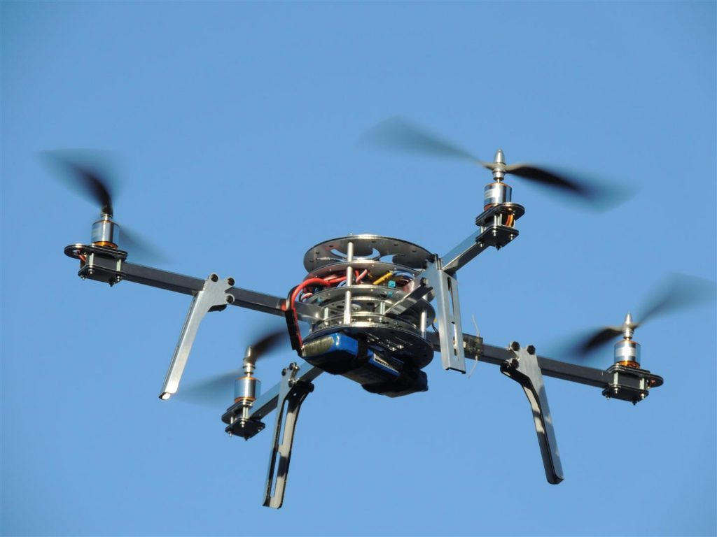
Types of Drones
Multi-rotor drones
This type of drone is the most common type of drone used amongst consumers. There uses include aerial photography, aerial video surveillance and amateur drone racing as well as leisure flying.
Tricopter – 3 rotors
Quadcopter – 4 rotors (most common type)
Hexacopter – 6 rotors
Octocopter – 8 rotors
Advantages | Disadvantages
Easy to manufacture | Limited flight time
Cheaper price | Limited endurance & speed
Easy to use | Uses large portion of energy to hover/stabilise in the air

Slide 4
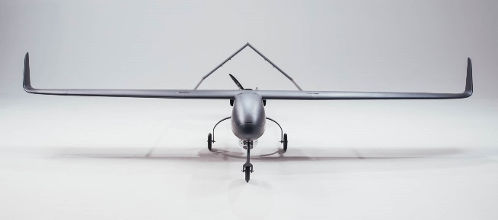
Fixed wing drones
Fixed wing drones are designed similar to how airplanes are designed, and they do not need to utilise energy to remain in the air instead it glides.
Advantages | Disadvantages
Can fly for a couple hours although the gas engine powered version can fly longer | Cannot hover in the air
Good for long distance flying | Cannot be used for aerial photography
 | High cost and requires skill training
 | Requires the use of a runway or catapult laucher

Slide 5
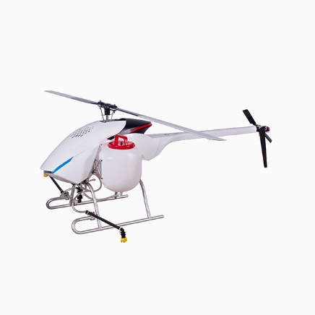
Single rotor drones
Similar design to a helicopter, has a big rotor and small rotor at the tail to control the heading
Advantages | Disadvantages
Higher flying times | Costs
Does not need a runway or catapult launcher | Complexity & operational risks e.g. fatal injuries
Can hover | Special training required

Slide 6
Ethical use
Drones are often used for personal/company use. Sometimes a company may use drones to gain a bird’s eye view of an area of operation so they can monitor an area of operation e.g. solar panel farms, mining operations.
Drones are used sometimes when manned aircraft cannot be used due to many factors such as air traffic, potential danger for a manned pilot. Therefore, a drone can be used instead as drones are smaller and cheap to replace and maintain compared to a manned aircraft pilot.

Slide 7
Unethical use
There has been reports made of unethical use of drones e.g. used to stalk/monitor people. A primary concern is safety as most drones fly at low attitude which can cause a danger to life if used in a populated area.
Military use of drones has been a topic such as the use of UAV’s as they have the potential to cause collateral damage and risk the potential of being hacked

Slide 8
Early warning system
Research was carried out using YouTube, reading articles.
Early warning is key to detecting threats and reducing the potential collateral damage that could take place. In the case of drones most airports will have this as the earlier the threat is countered the better the situation with detecting the drone and using the most effective method for countering drones. In addition to this you can detect which drone is a friendly drone(e.g. owned by you or your company) or an enemy drone(random drone or a spy drone that could be linked to industrial espionage).
– My interpretation from current knowledge
Radar and soundwaves are often used in early warning systems as they can track when objects are in range, but both come with advantages and disadvantages.

Slide 9
Abstract
“Drones have a unique history which started with being used for military applications and only in recent history to be used for private and commercial uses. In the right hands drones can be a force for good and saves lives whereas in the wrong hands drones have the potential to cause insurmountable collateral damage. The aim of this project is to find a solution to counter drones which a commercial drone and software define radio(SDR) will be used. Drones are controlled between the frequencies of 2.5 to 5.8GHz, although the signal can be jammed at 1.5GHz. Through the use of GPS spoofing a drone’s location can be false which may can cause a drone to either not fly or receive a signal from the flyer.”
Although this is not the final version details mentioned in the abstract above will be used in the final version

Slide 10
Decision
Choices available:
SDR
Early warning system
GPS spoofing
At the present time I am stuck between the choosing early warning system and GPS spoofing

Slide 11
CAA regulations summary
Regulations affecting Drones
Article 240 – endangering safety of an aircraft
Article 241 – endangering safety of any person or property
Article 94 – small unmanned aircraft: requirements
Article 94A – small unmanned aircraft; permissions for certain flights
Article 94B – small unmanned aircraft: Interpretation of expressions use in the definition of “flight restriction zone”
Article 95 – small unmanned surveillance aircraft
In Article 94A there is a height limitation of 400ft for flying drones.

Slide 12
Other research conducted
GPS spoofing this was done through watching YouTube videos and article research
Software defined radio (SDR) was through online articles and websites as well YouTube for examples of practical uses

